Slide 1
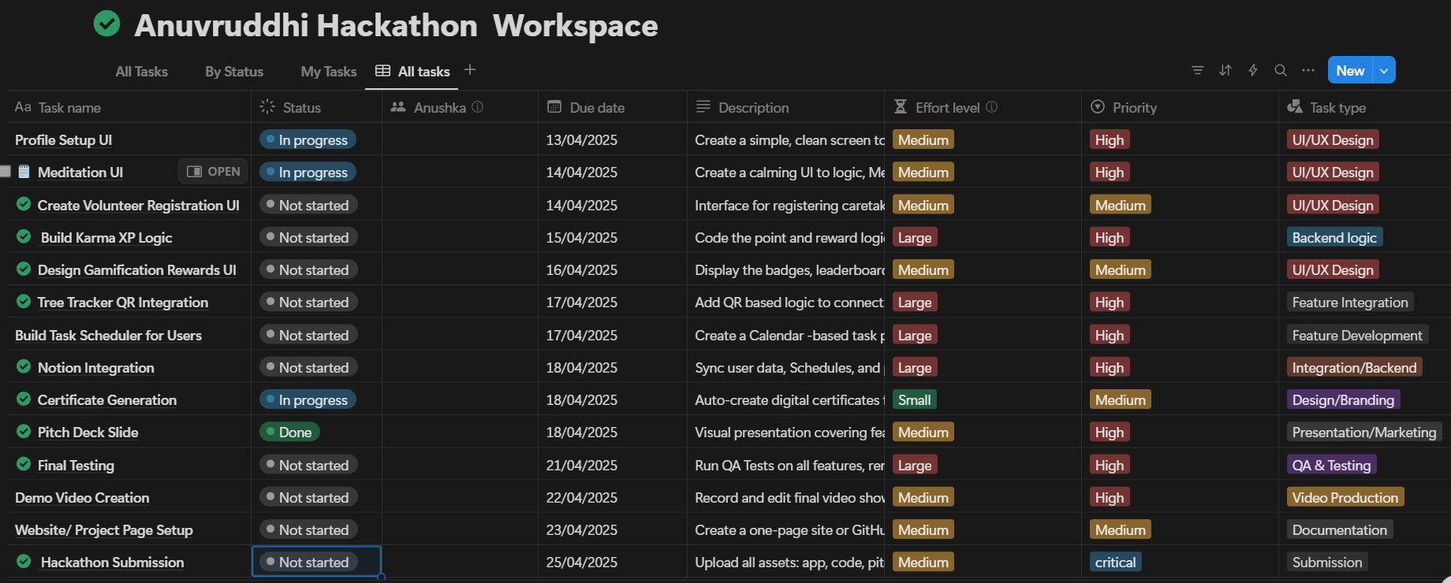
Hackathon project: Anuvruddhi on 13 April,2025

Slide 2
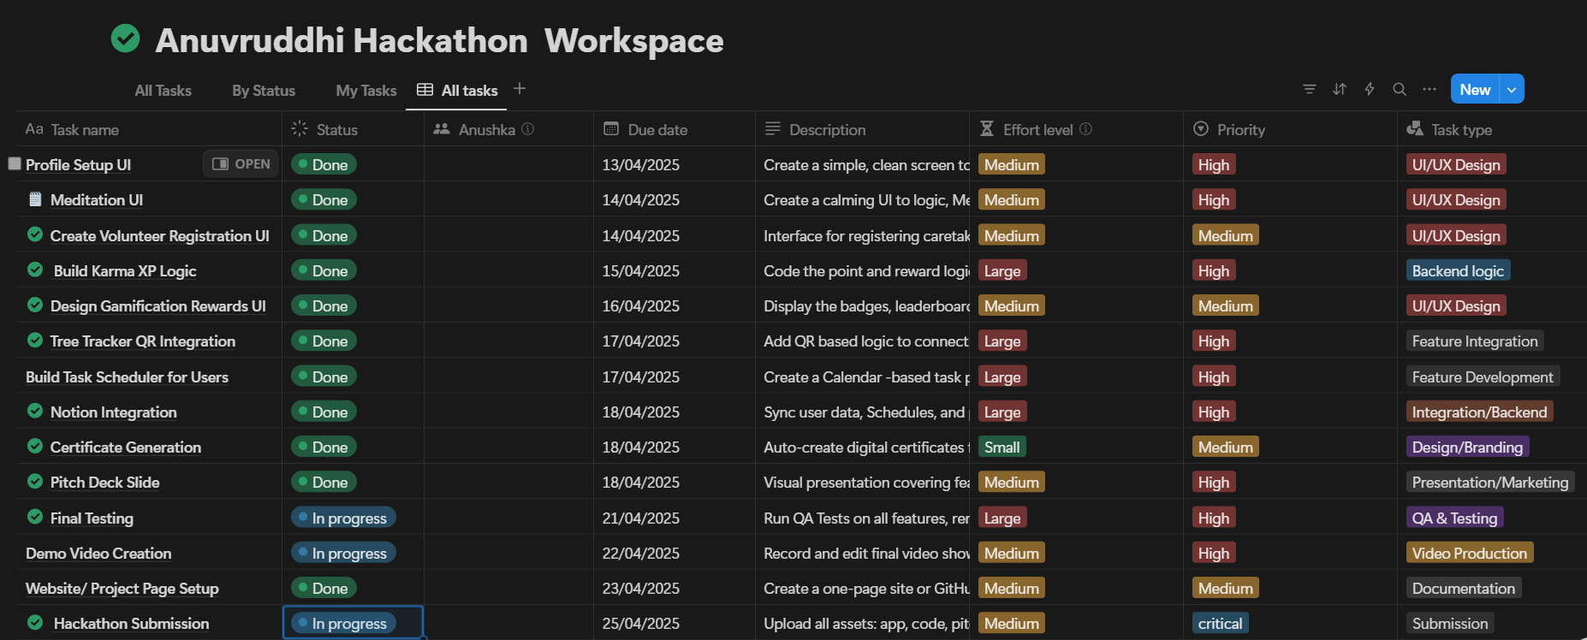
Hackathon Project : Anuvruddhi on 25 April,2025

